Slide 1


Notes:
Todays assembly is about moving more, and getting our families moving together!

Slide 2
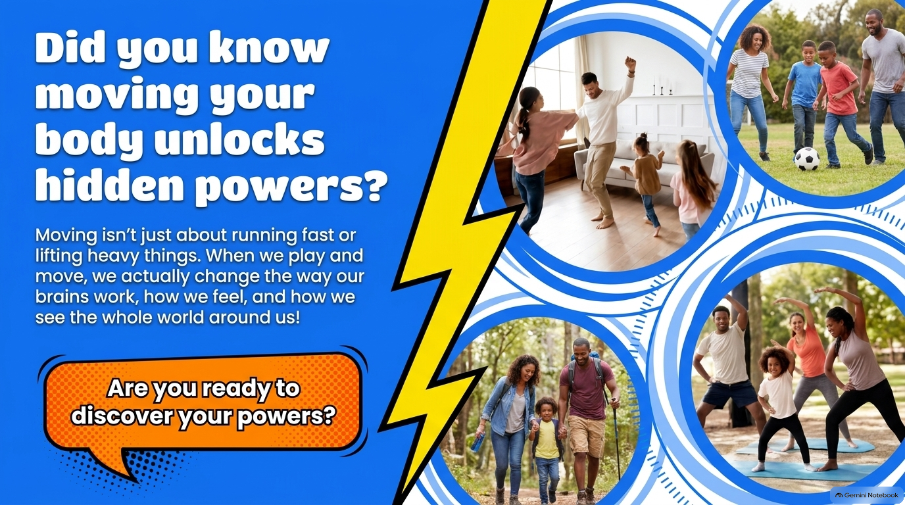
Notes:
By moving more we don't just change how our bodies work, we also change how our brains work- mrmory, gets better, problem solving is easier, stress is reduced. By moving more and becoming more active it also changes how we see the world around us- we become more positive, more energetic and more ready to seize amazing opportunities.

Slide 3
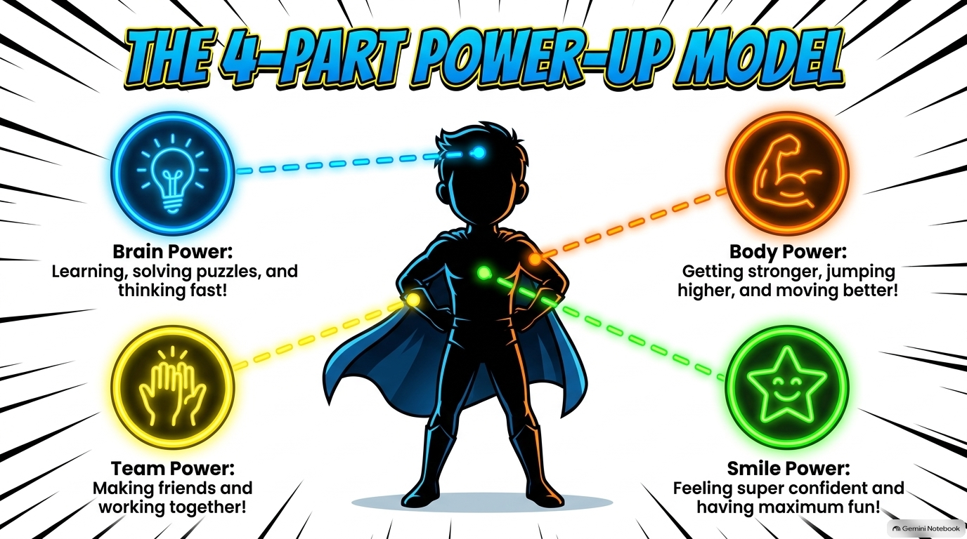
Notes:
This slide talks about the benefits of moving- on our bodies, minds, socially and also the benefits on our own identities.

Slide 4
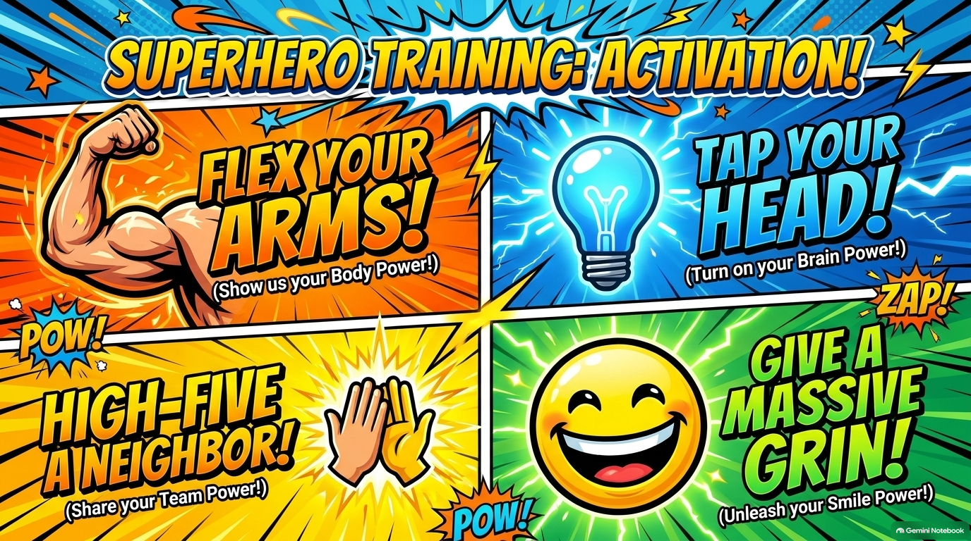
Notes:
If comfortable get all children in the assembly to perform these 4 things

Slide 5
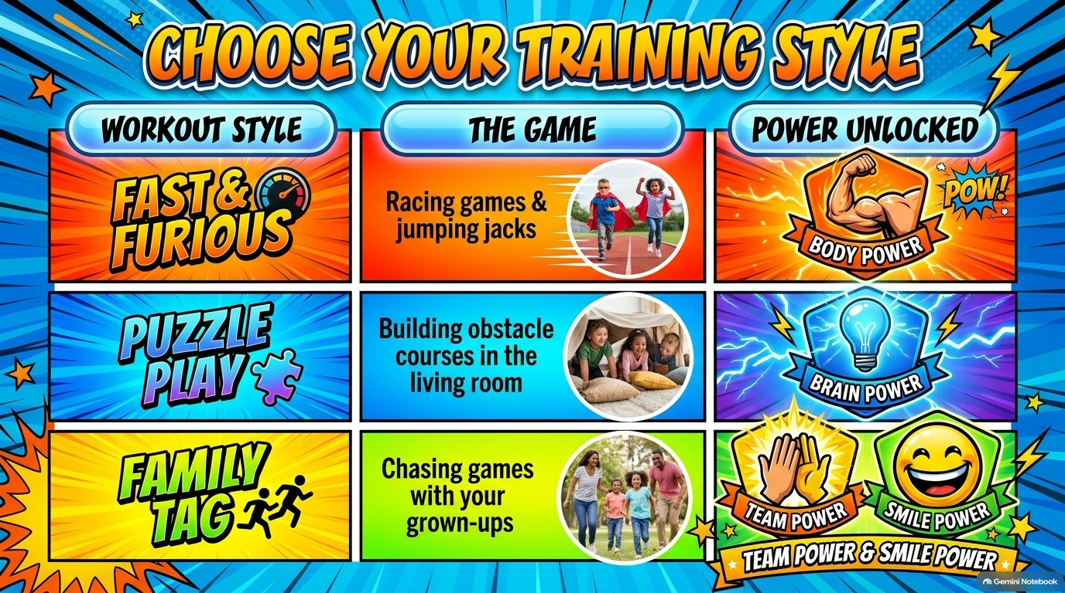
Notes:
Remember- everyone is different. Not everyone enjoys the same thing. When you pick your games think about the type of games you like, think about what your grown ups like. Can you combine the two or create something new? Sometimes it's good to compete against each other, sometimes it's nice to work with each other. You could even combine different activities to make a program.

Slide 6
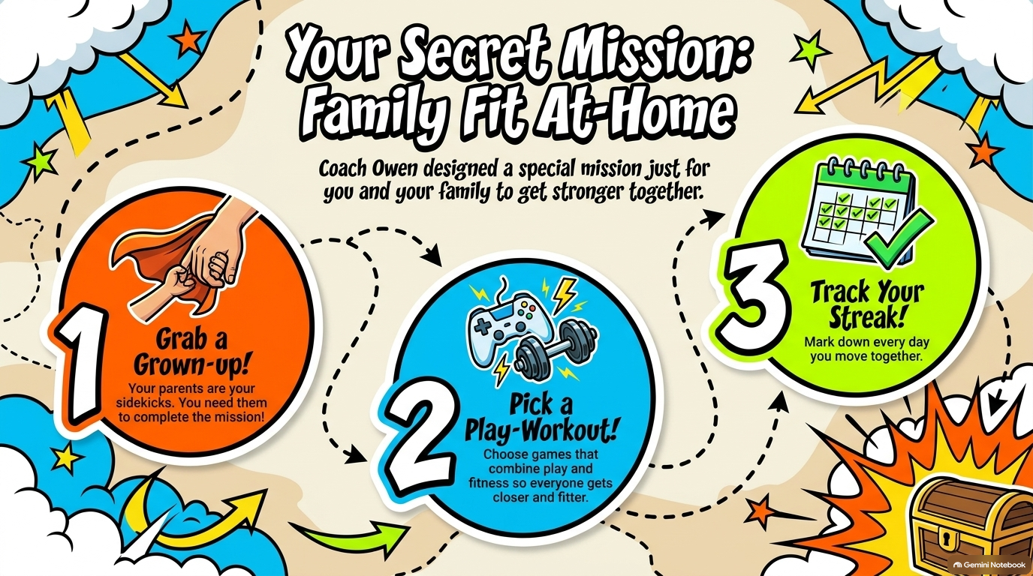
Notes:
So now you know why activity is so good let's look at how to make real changes. We will move more if our family joins in with us, then pick a game or activity you might all enjoy. Once you've done it, keep track of your active day. The research says that if we actively track things, we are more likely to stick to them. This is true for grown ups too.

Slide 7
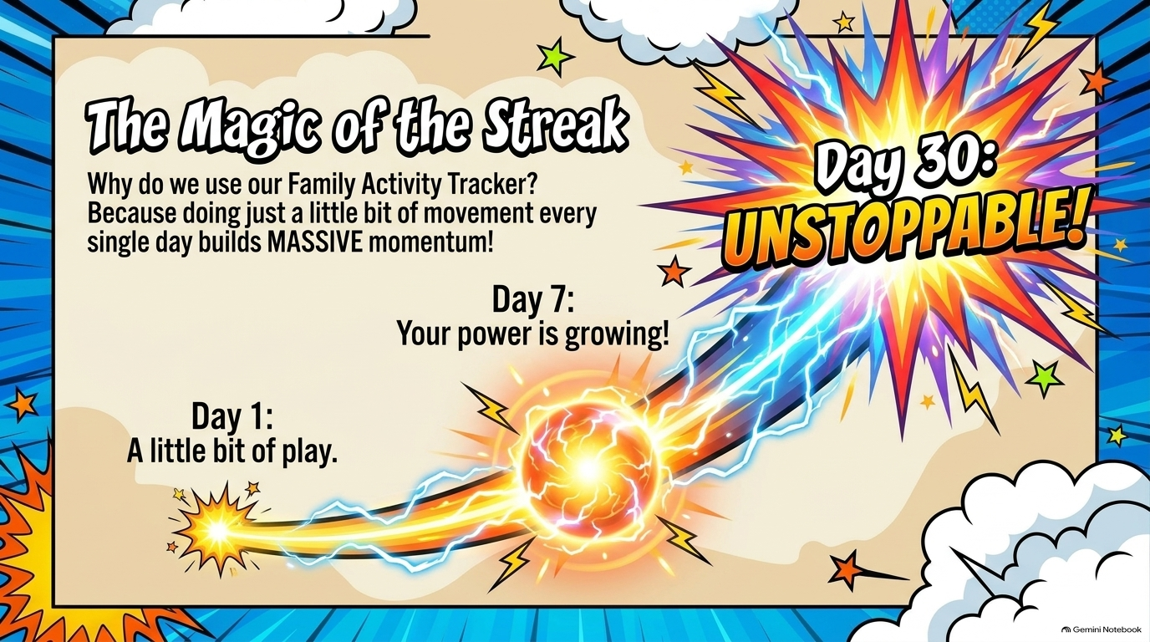
Notes:
Building an activity streak takes time. It won't be easy straight away and you might need to start again once or twice. If you manage to do a little bit of something everyday momentum builds. If you manage to complete 30 day of moving you will have made a massive difference and you will feel noticably better.

Slide 8

Notes:
To really get going we need to be in this together-
You need to take the opportunities, find your thing and choose to move
Be the ambassador for your family, get them going with you. SHow them how much fun they can have with you.
Make the most of school- we give you lots of chances to move, are you making the most of these? Tell us how we can include more moving in our learning and throughout the day.

Slide 9

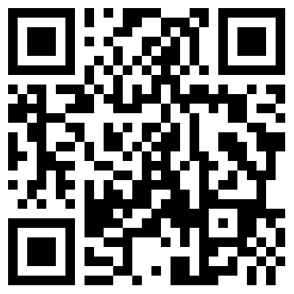
Notes:
Every class will get given an activity tracker. Show the tracker
Take it home and access the games and workouts or make your own fun. Whoever is most active. Wins the week.

